Slide 1
CS F415: Data Mining
Yashvardhan Sharma

Slide 2
Today’s Outline
Data Preprocessing
Data Quality
Data Preprocessing Steps

Slide 3
Multi-Dimensional Measure of Data Quality
A well-accepted multidimensional view:
Accuracy
Completeness
Consistency
Timeliness
Believability
Value added
Interpretability
Accessibility
Broad categories:
intrinsic, contextual, representational, and accessibility.

Slide 4
Major Tasks in Data Preprocessing
outliers=exceptions!
Data cleaning
Fill in missing values, smooth noisy data, identify or remove
outliers, and resolve inconsistencies
Data integration
Integration of multiple databases, data cubes, or files
Data transformation
Normalization and aggregation
Data reduction
Obtains reduced representation in volume but produces the same or similar analytical results
Data discretization
Part of data reduction but with particular importance, especially for numerical data

Slide 5
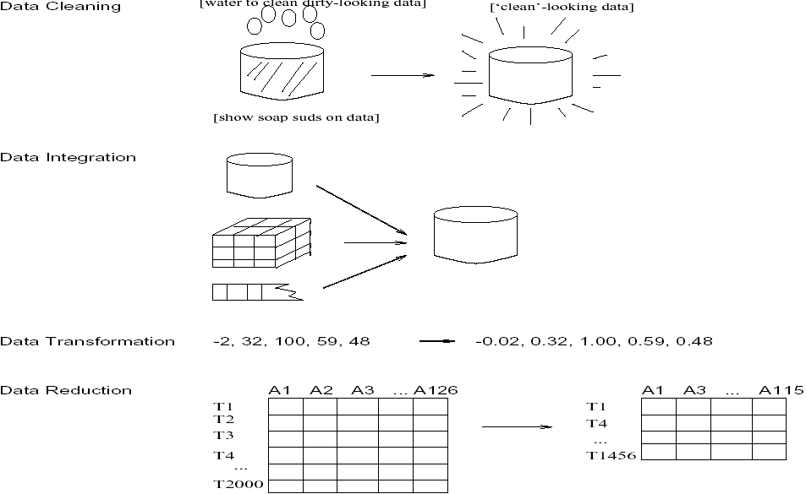
Forms of data preprocessing

Slide 6
Data Quality
What kinds of data quality problems?
How can we detect problems with the data?
What can we do about these problems?
Examples of data quality problems:
Noise and outliers
missing values
duplicate data

Slide 7
Data Cleaning
Importance
“Data cleaning is one of the three biggest problems in data warehousing”—Ralph Kimball
“Data cleaning is the number one problem in data warehousing”—DCI survey
Data cleaning tasks
Fill in missing values
Identify outliers and smooth out noisy data
Correct inconsistent data
Resolve redundancy caused by data integration

Slide 8
Missing Data
Data is not always available
E.g., many tuples have no recorded value for several attributes, such as customer income in sales data
Missing data may be due to
equipment malfunction
inconsistent with other recorded data and thus deleted
data not entered due to misunderstanding
certain data may not be considered important at the time of entry
not register history or changes of the data
Missing data may need to be inferred.

Slide 9
Missing Values
Reasons for missing values
Information is not collected (e.g., people decline to give their age and weight)
Attributes may not be applicable to all cases (e.g., annual income is not applicable to children)
Handling missing values
Eliminate Data Objects
Estimate Missing Values
Ignore the Missing Value During Analysis
Replace with all possible values (weighted by their probabilities)

Slide 10
How to Handle Missing Data?
Ignore the tuple: usually done when class label is missing (assuming the tasks in classification—not effective when the percentage of missing values per attribute varies considerably.
Fill in the missing value manually: tedious + infeasible?
Fill in it automatically with
a global constant : e.g., “unknown”, a new class?!
the attribute mean
the attribute mean for all samples belonging to the same class: smarter
the most probable value: regression, inference-based such as Bayesian formula or decision tree

Slide 11
Noisy Data
Noise: random error or variance in a measured variable
Incorrect attribute values may due to
faulty data collection instruments
data entry problems
data transmission problems
technology limitation
inconsistency in naming convention
Other data problems which requires data cleaning
duplicate records
incomplete data
inconsistent data

Slide 12
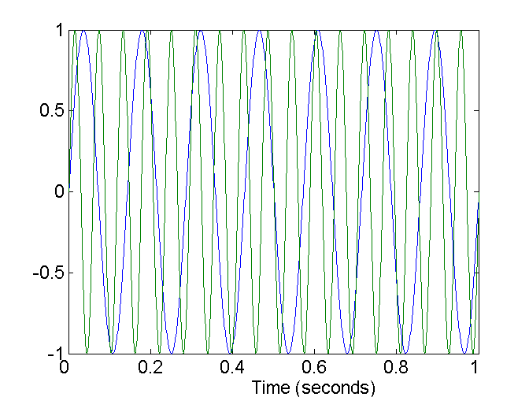
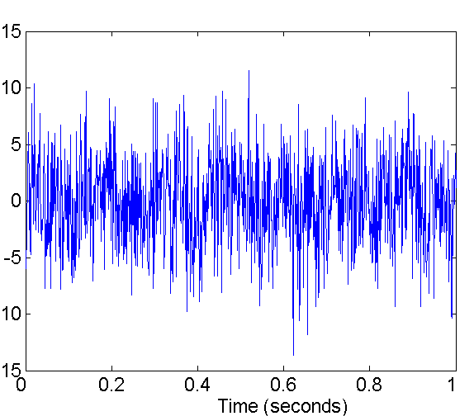
Noise
Noise refers to modification of original values
Examples: distortion of a person’s voice when talking on a poor phone
Two Sine Waves
Two Sine Waves + Noise

Slide 13
How to Handle Noisy Data?
Binning method:
first sort data and partition into (equi-depth) bins
then one can smooth by bin means, smooth by bin median, smooth by bin boundaries, etc.
Clustering
detect and remove outliers
Combined computer and human inspection
detect suspicious values and check by human (e.g., deal with possible outliers)
Regression
smooth by fitting the data into regression functions

Slide 14
Simple Discretization Methods: Binning
Equal-width (distance) partitioning:
Divides the range into N intervals of equal size: uniform grid
if A and B are the lowest and highest values of the attribute, the width of intervals will be: W = (B –A)/N.
The most straightforward, but outliers may dominate presentation
Skewed data is not handled well.
Equal-depth (frequency) partitioning:
Divides the range into N intervals, each containing approximately same number of samples
Good data scaling
Managing categorical attributes can be tricky.

Slide 15
Binning Methods for Data Smoothing
Sorted data (e.g., by price)
4, 8, 9, 15, 21, 21, 24, 25, 26, 28, 29, 34
Partition into (equi-depth) bins:
Bin 1: 4, 8, 9, 15
Bin 2: 21, 21, 24, 25
Bin 3: 26, 28, 29, 34
Smoothing by bin means:
Bin 1: 9, 9, 9, 9
Bin 2: 23, 23, 23, 23
Bin 3: 29, 29, 29, 29
Smoothing by bin boundaries:
Bin 1: 4, 4, 4, 15
Bin 2: 21, 21, 25, 25
Bin 3: 26, 26, 26, 34

Slide 16
Cluster Analysis

Slide 17
Regression
y
Y1
Y1’
y = x + 1
X1
x

Slide 18
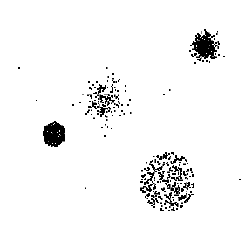
Outliers
Outliers are data objects with characteristics that are considerably different than most of the other data objects in the data set

Slide 19
Duplicate Data
Data set may include data objects that are duplicates, or almost duplicates of one another
Major issue when merging data from heterogeneous sources
Examples:
Same person with multiple email addresses
Data cleaning
Process of dealing with duplicate data issues

Slide 20
Data Preprocessing
Aggregation
Sampling
Dimensionality Reduction
Feature subset selection
Feature creation
Discretization and Binarization
Attribute Transformation

Slide 21
Data Reduction Strategies
A data warehouse may store terabytes of data
Complex data analysis/mining may take a very long time to run on the complete data set
Data reduction
Obtain a reduced representation of the data set that is much smaller in volume but yet produce the same (or almost the same) analytical results
Data reduction strategies
Data cube aggregation
Dimensionality reduction — remove unimportant attributes
Data Compression
Discretization and concept hierarchy generation

Slide 22
Aggregation
Combining two or more attributes (or objects) into a single attribute (or object)
Purpose
Data reduction
Reduce the number of attributes or objects
Change of scale
Cities aggregated into regions, states, countries, etc
More “stable” data
Aggregated data tends to have less variability

Slide 23
Data Cube Aggregation
The lowest level of a data cube
the aggregated data for an individual entity of interest
e.g., a customer in a phone calling data warehouse.
Multiple levels of aggregation in data cubes
Further reduce the size of data to deal with
Reference appropriate levels
Use the smallest representation which is enough to solve the task
Queries regarding aggregated information should be answered using data cube, when possible

Slide 24
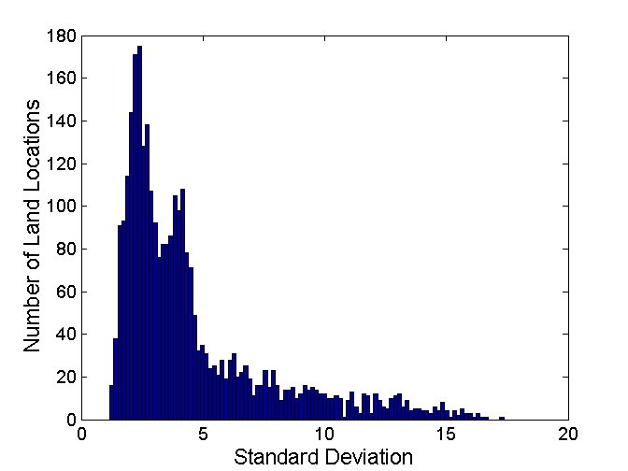
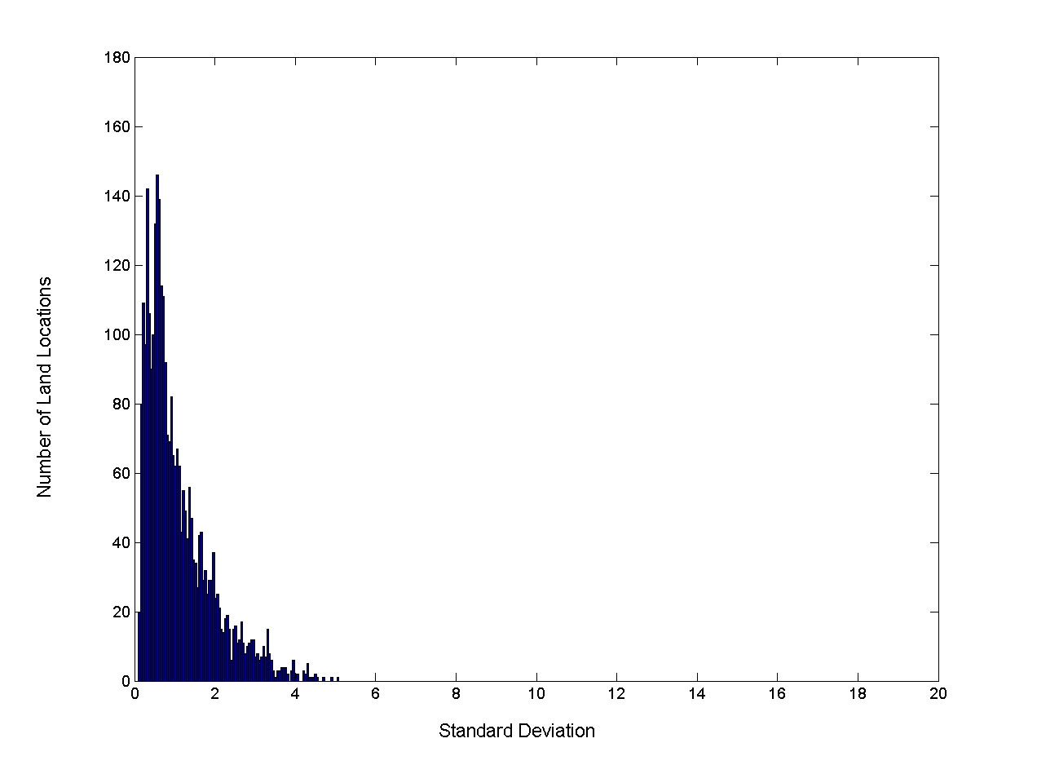
Aggregation
Variation of Precipitation in Australia
Standard Deviation of Average Monthly Precipitation
Standard Deviation of Average Yearly Precipitation

Slide 25
Sampling
Sampling is the main technique employed for data selection.
It is often used for both the preliminary investigation of the data and the final data analysis.
Statisticians sample because obtaining the entire set of data of interest is too expensive or time consuming.
Sampling is used in data mining because processing the entire set of data of interest is too expensive or time consuming.

Slide 26
Sampling …
The key principle for effective sampling is the following:
using a sample will work almost as well as using the entire data sets, if the sample is representative
A sample is representative if it has approximately the same property (of interest) as the original set of data

Slide 27
Types of Sampling
Simple Random Sampling
There is an equal probability of selecting any particular item
Sampling without replacement
As each item is selected, it is removed from the population
Sampling with replacement
Objects are not removed from the population as they are selected for the sample.
In sampling with replacement, the same object can be picked up more than once
Stratified sampling
Split the data into several partitions; then draw random samples from each partition

Slide 28
Sampling
Allow a mining algorithm to run in complexity that is potentially sub-linear to the size of the data
Choose a representative subset of the data
Simple random sampling may have very poor performance in the presence of skew
Develop adaptive sampling methods
Stratified sampling:
Approximate the percentage of each class (or subpopulation of interest) in the overall database
Used in conjunction with skewed data
Sampling may not reduce database I/Os (page at a time).

Slide 29
Sampling
SRSWOR
(simple random
sample without
replacement)
SRSWR
Raw Data

Slide 30
Sampling
Raw Data
Cluster/Stratified Sample

Slide 31

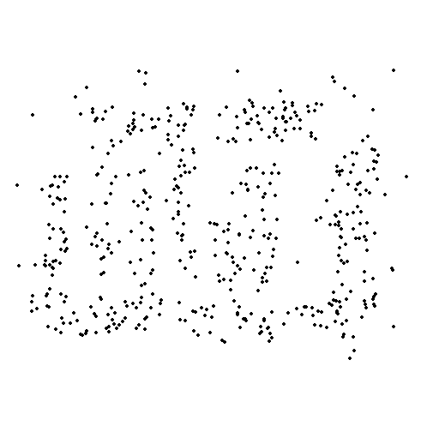
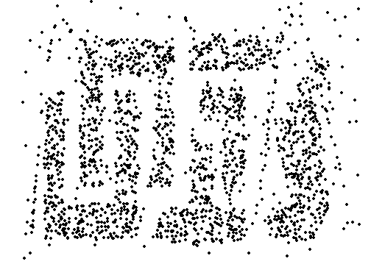
Sample Size
8000 points 2000 Points 500 Points

Slide 32
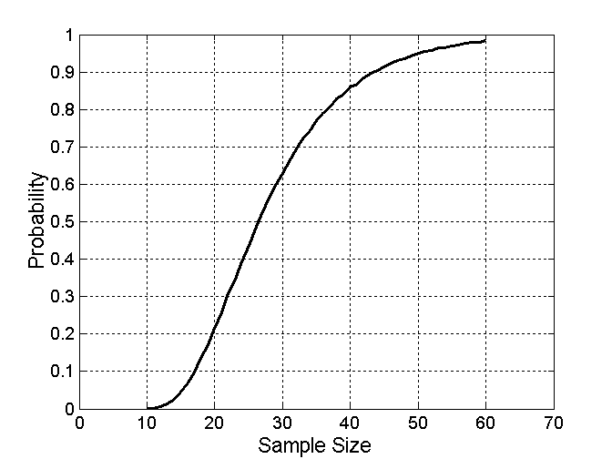

Sample Size
What sample size is necessary to get at least one object from each of 10 groups.

Slide 33
Dimensionality Reduction
Feature selection (i.e., attribute subset selection):
Select a minimum set of features such that the probability distribution of different classes given the values for those features is as close as possible to the original distribution given the values of all features
reduce # of patterns in the patterns, easier to understand
Heuristic methods (due to exponential # of choices):
step-wise forward selection
step-wise backward elimination
combining forward selection and backward elimination
decision-tree induction

Slide 34
Dimensionality Reduction
Purpose:
Avoid curse of dimensionality
Reduce amount of time and memory required by data mining algorithms
Allow data to be more easily visualized
May help to eliminate irrelevant features or reduce noise
Techniques
Principle Component Analysis
Singular Value Decomposition
Others: supervised and non-linear techniques

Slide 35
Example of Decision Tree Induction
Initial attribute set:
{A1, A2, A3, A4, A5, A6}
A4 ?
A1?
A6?
Class 1
Class 2
Class 1
Class 2
>
Reduced attribute set: {A1, A4, A6}

Slide 36
Heuristic Feature Selection Methods
There are 2^{d} possible sub-features of d features
Several heuristic feature selection methods:
Best single features under the feature independence assumption: choose by significance tests.
Best step-wise feature selection:
The best single-feature is picked first
Then next best feature condition to the first, ...
Step-wise feature elimination:
Repeatedly eliminate the worst feature
Best combined feature selection and elimination:
Optimal branch and bound:
Use feature elimination and backtracking

Slide 37
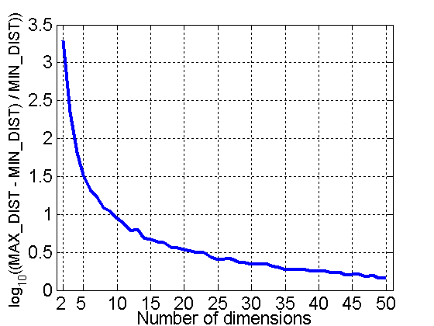
Curse of Dimensionality
When dimensionality increases, data becomes increasingly sparse in the space that it occupies
Definitions of density and distance between points, which is critical for clustering and outlier detection, become less meaningful
Randomly generate 500 points
Compute difference between max and min distance between any pair of points

